Slide 1
Central Massachusetts Regional Public Health Alliance
Michael Hirsh, MD, Commissioner
Derek Brindisi , MPA, Director

Slide 2
Mission:
To improve, promote, and protect the health and safety of residents in six Central Massachusetts municipalities through the formation of strong community partnerships, data-driven decision-making, and delivery of high quality public health services.
Vision:
The Central Massachusetts Regional Public Health Alliance will be a nationally recognized model for an efficient, effective, and equitable multi-jurisdictional public health system that serves the healthiest region in New England.
Notes:
Developed in 2013 as part of the Alliance’s strategic planning process
Public Health is more than regulatory responsibilities-the CMRPHA places equal value on community health, emergency preparedness, communicable disease control, and environmental health.

Slide 3
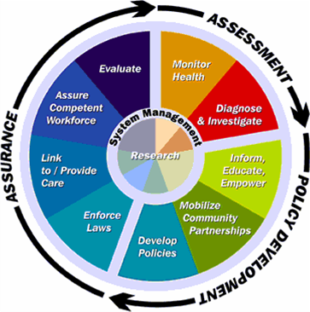
The 10 Essential Public Health Services
Notes:
Major goal of the CMRPHA is to provide the 10 essential services of public health to the entire region-would not be possible without the alliance
Developed in response to the 1988 IOM report on the state of public health in the U.S.
Development of a common framework for understanding the capacities needed to fulfill the mission of public health
1988 – 3 core functions of public health
Assessment
Monitoring health status to identify health issues
Investigation/diagnosis of health issues and hazards
Assurance
Assures the community can count on a competent public and personal care workforce
Links people to personal health services
Policy Development
Develop policies and plans that support health
Enforce laws and regulations that protect health and ensure safety
1994 – development of the 10 essential public health services framework

Slide 4
History
Regionalizing Public Health services was a recommendation of the 2009 Worcester Public Health Task Force Report
Health Foundation of Central MA
District Incentives Grant (DIG)
5 year grant awarded to WDPH in 2011 to support regionalization
Notes:
DIG-awarded by MassDPH to several regions in the state to fund regionalization in an effort to address reduce disparities in the capacity of local public health agencies and strengthen workforce qualifications

Slide 5
Alliance Structure
A coalition of 6 municipalities (Holden, Leicester, Millbury, Shrewsbury, West Boylston and the City of Worcester)
Working cooperatively to create and sustain a viable, cost-effective, and labor-efficient regional public health district.
The alliance provides a comprehensive array of services to partner municipalities through a single organization managed by Worcester’s Division of Public Health.
Each town has an individual agreement with the City of Worcester outlining the services to be provided by each party

Slide 6
Major Goals
Achieve National Accreditation by 2015
Streamline processes and services
Robert Wood Johnson Grant
Improve the health status of the region through data driven programming
CHA/CHIP
Notes:
CMRPHA is building a culture of continuous quality improvement through various efforts-standardization, workforce development, accreditation etc.

Slide 7
Robert Wood Johnson Foundation Grant
Goal 1 Create a sustainable public health district that provides high quality, affordable services in accordance with the 10 Essential Public Health Services framework | 1.1: Carefully document current & future financial resources 1.1a: Assessment of revenue sources 1.1b: Cost-analysis of service delivery 1.1c: Cost-analysis of CHIP Implementation
 | 1.2: Develop a plan to actively pursue all sources of funding 1.2a: Conduct an assessment of local funding opportunities 1.2b: Review current fee structure for each community in the region
 | 1.3: Develop a plan to pursue opportunities related to health care reform 1.3a: Explore natural areas of synergy
Goal 2 Improve the scope, quality, and efficiently of local public health services delivered in Central Mass | 2.1: Strengthen the qualifications of public health workforce and provide consist practice in delivery of services 2.1a: Conduct an assessment to identify additional staff training needs 2.1b: Conduct an analysis of each community's regulatory capabilities, policies, and procedures
 | 2.2: Prepare for national accreditation by 2015 2.2a: Utilize PHAB domains to guide RWJ work
Notes:
RWJ is a 2 year grant to supporting quality improvement efforts; CMRPHA is actively working toward the goals & objectives outlined here to improve service delivery.
-To date we have completed a review of each community’s fee structure (1.2b) and are making progress with accreditation (2.2); we have also begun a time motion analysis of our environmental health staff (1.1b) in an effort to quantify the amount of resources required for these programs (food inspections, housing etc.) to maximize efficiency and cost-effectiveness

Slide 8
State Mandated Public Health Services
Records, Record Keeping, and Reporting
Communicable Disease Control
Enforce Sanitary Codes for Housing
Enforce lead poisoning prevention
Inspection of public facilities (e.g., restrooms)
Ensure site for hazardous waste disposal
Ensure site for solid waste disposal
Ensure safe and adequate storage of medical and biological waste
Enforce Title V codes for septic waste disposal
Make rules and regulations for the removal, transportation and disposal of garbage
Investigate nuisances that may be injurious to health
Issue permits for all food service establishments
Inspect retail food establishments (temporary and permanent) at least two times per year
Inspect and monitor quality of public pools and beaches
Inspect camps, mobile home parks, and cabins
Enforce local and state smoking regulations
Notes:
This list is not comprehensive-each of these mandates have multiple parts and the state mandated functions are mainly related to EH and Comm Diseases, the CMRPHA has mandates to do CH/EP through grant deliverables
CMRPHA also has regional mandates through IMAs to provide health education, interact with the media, provide technical assistance regarding policy development etc.

Slide 9
Community Health Planning
Year long assessment involving over 125 community leaders and 90 organizations
Community Health Assessment (CHA) process involved extensive data collection and analysis
State Data
Focus Groups
On-line Surveys
Key Informant Interviews
Notes:
The community health assessment and community health improvement plan are pre-requisites for PHAB accreditation; completed in 2012

Slide 10
Community Health Improvement Plan (CHIP)
CHIP involved the synthesis of CHA data to develop a 5 year work plan for the CMRPHA and community partners
5 Priority Areas: Healthy Eating/Active Living, Behavioral Health, Access to Primary Care, Violence/Injury Prevention and Health Equity
Each area has a series of specific objectives and strategies
The department facilitates a workgroup for each of the domains that is responsible for implementing the plan

Slide 11
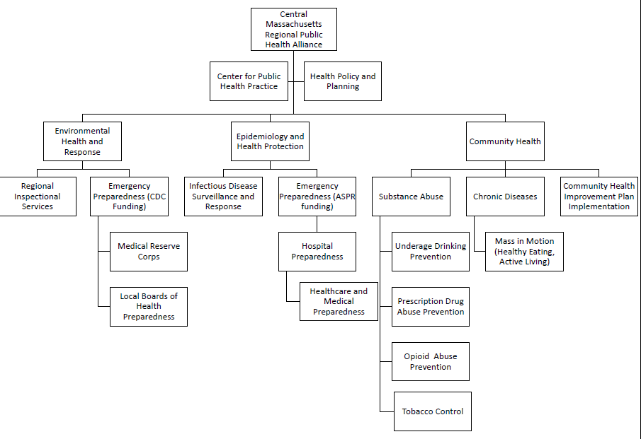
Notes:
Organizational Structure of Alliance Programs; 3 major areas: Environmental Health, Epidemiology and Nurses, and Community Health
Alliance towns have access to all programs and services and

Slide 12
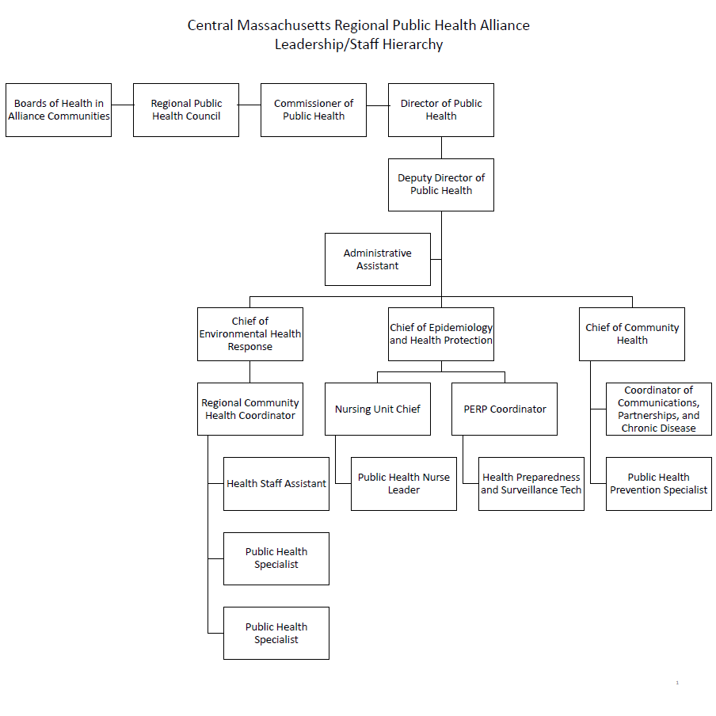

Slide 13
Financial Picture
*Does not include project-related expenses and contract positions
*Excludes 3 new grants since the beginning of FY14
Notes:
Total Operating Budget for the CMRPHA = $ 1,372,847
Municipal Contributions = $652,394
Grants = $ 583,453 (excluding project-related expenses and contract positions)
Contracts/grants figure does not include $661,506 for county-wide emergency preparedness funds and approximately $317,617 for grant-related expenses
Contracts/grant figure excludes 3 new grants since beginning of the year ($137,000)

Slide 14
Notes:
Total Grant Revenue = $1,699,576
Regional emergency preparedness = $661,516
These funds are in addition to the monies in the operating budget

Slide 15
Accreditation
CMRPHA is committed to achieving voluntary accreditation by 2015
2/3 of the pre-requisites completed and the 3rd is well underway
Focusing on standardization in compliance with the standards
Benefits of PHAB Accreditation | Promotes high performance and continuous quality improvement Illustrates health department accountability to both policymakers and the public Provide a framework for improved service delivery consistent with the “10 Essential Services of Public Health” Increases the visibility of the health department, leading to greater public trust and increased credibility of the department as a health authority Clarifies the public’s expectation of health departments
Notes:
Also a recommendation of the 2009 Public Health Task Force Report; Great time for CMRPHA to undertake the accreditation process because going through the standards and measures allows us to think strategically about the way that we operate and gives us an opportunity to make strategic improvements

Slide 16
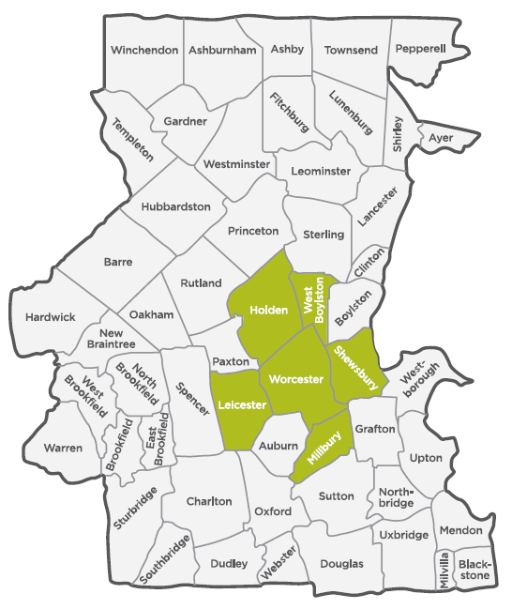
Benefits
Increased access to resources
Expanded services
Enhanced staff capacity
Access to a larger network of community partners
Notes:
1+2) By pooling resources from 6 municipalities CMRPHA towns are able to provide a wider range of services including CH, EH, EP & Comm. Dis; more grant options b/c of increased availability of knowledge/expertise & administrative capacity to administer them
3) CMRPHA encourages staff cross training and has more capacity to provide coverage Ex/ extra staff to assist inspectors so that routine food inspections are not behind etc.
These factors lead to a stronger regional system with an increased ability to perform routine functions but also to systematically monitor and respond to changes in the population’s health status ie-the CHA/CHIP process

Slide 17
Questions?

